Slide 1

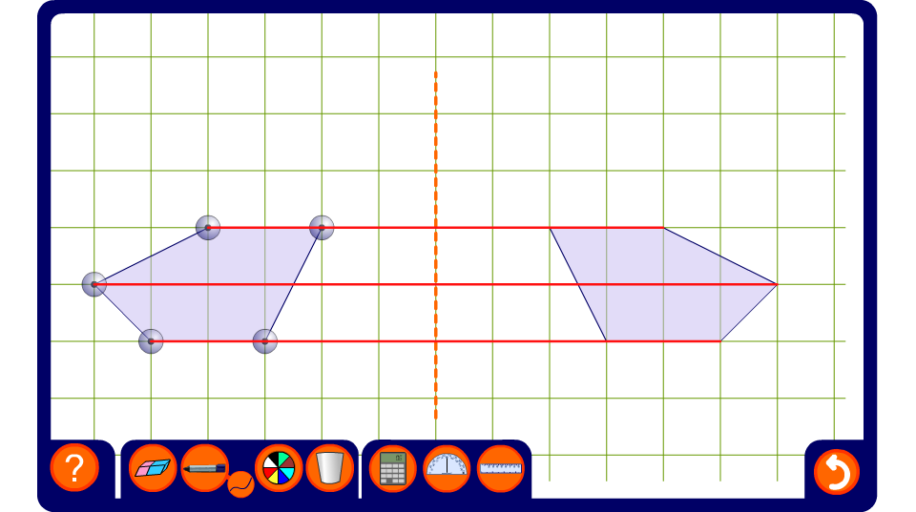


Reflecting shapes
Notes:
Use this activity to dynamically prove the result on the previous slide.

Slide 2
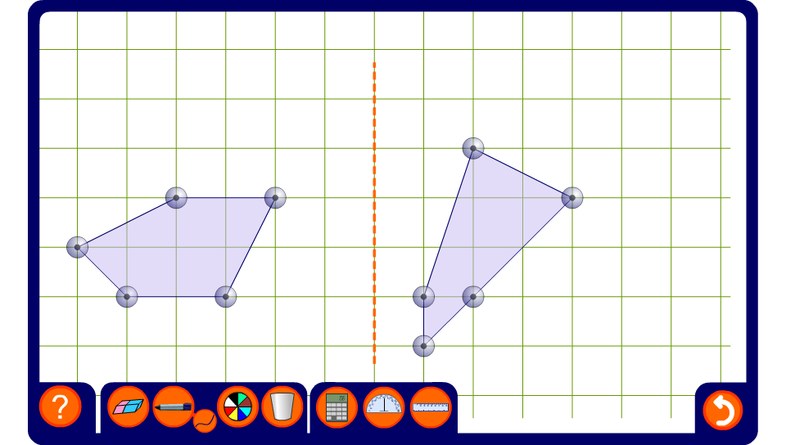
Reflect this shape
Notes:
Modify one of the pentagons by dragging its vertices and define it as the image. Position the shape by dragging on its centre. Ask a volunteer to come to the board and reflect the shape by modifying the other pentagon. If necessary, use the pen tool (set to draw straight lines) to connect the points in the object to the mirror line. Instruct the volunteer to reflect these lines to find the positions of the image points.

